Slide 1
The Best IaC Tool In The World! (in my opinion)
Ryan Bartram | Jan Oehen

Slide 2

Many thanks to our sponsors:

Slide 3


Ryan Bartram
Both Azure Cloud Engineers
Both Automation/pwsh Advocates
Both work at Worxspace
In other words
Same same, but different…
But still same
Jan Oehen

Slide 4
Slide title
Sample text for your PSConf.EU 2022 presentation
We usually prefer demos, use slides with moderation
Think about those at the back of the room, some text might be too small.
Think about accessibility, try to improve the contrast, colours and size of your presentation.

Slide 5
Instructions
Use this template if you want, it’s preferred but not mandatory.
Please make sure our sponsors are mentioned on your first slide after the title.
Do not amend the ratio or the colours of the sponsors’ logo and background.
Update your twitter handle through the master page (see next slides).

Slide 6
Instruction (Continued)
The session is 30 min.
Then 15min Q&A.
At the end of your 45 min, please leave the room to the next speaker.
You’re welcome to continue the discussion in the Foyer area.

Slide 7
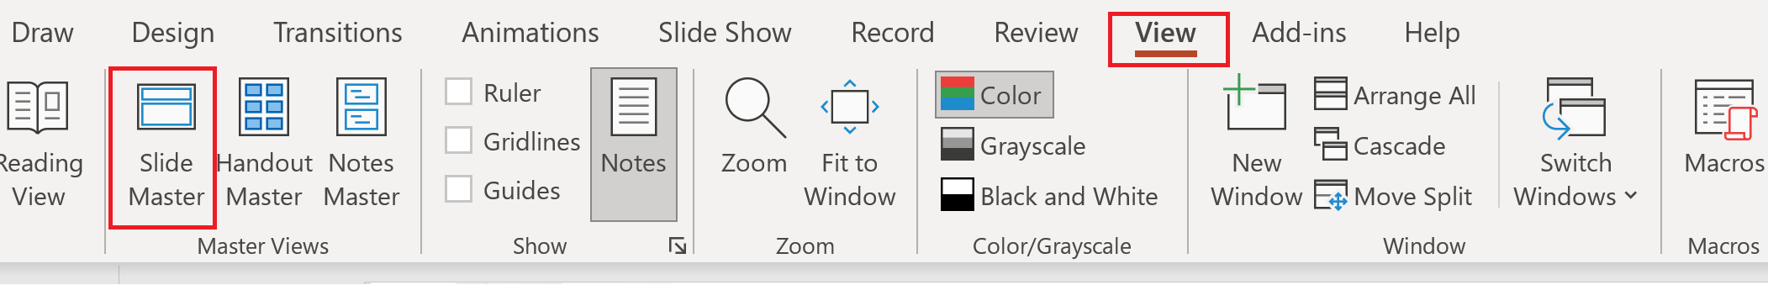
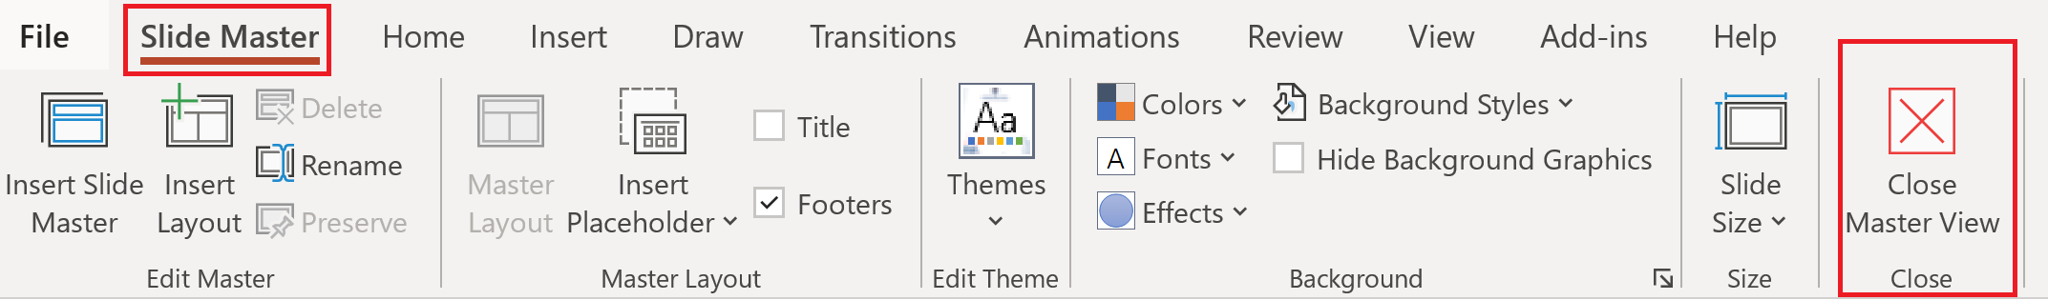
Update the twitter handle on the master slide
To open the slide master:
To close the Master view:
If you need any help, do not hesitate to email us at psconfeu@synedgy.com

Slide 8


Are you already onboard?
Newbie
No experience of IaC
Not yet scarred by failure
Perfect time to start
Seasoned Vet
Seen many builds fail
Likely loyal to the tool and very opinionated
Perfect time to switch

Slide 9
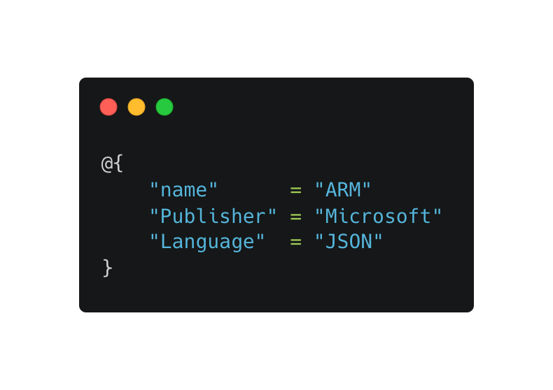
Challenger 1
SHOW-TOOL

Slide 10
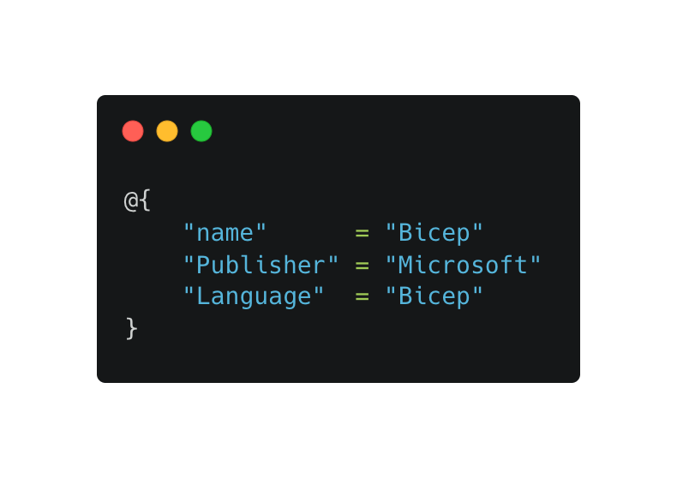
Challenger 2
SHOW-TOOL

Slide 11
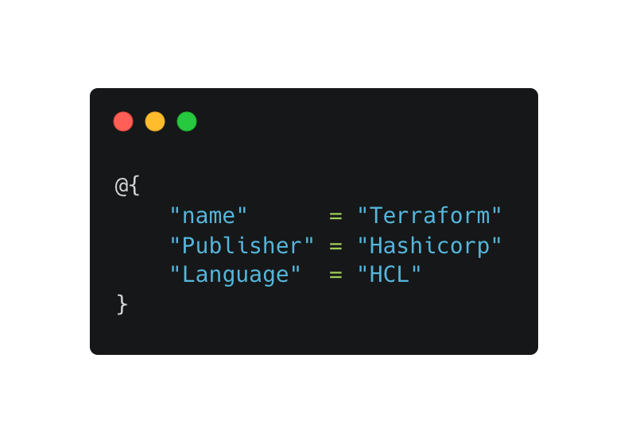
Challenger 3
SHOW-TOOL

Slide 12
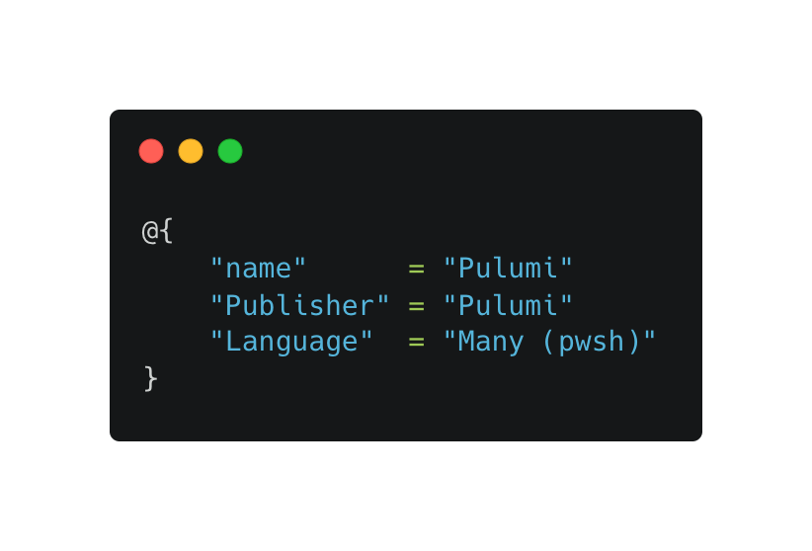
Challenger 4
SHOW-TOOL

Slide 13
Demos
We love Demos!

Slide 14
Q&A
15 minutes

